Slide 1
Project Overview
Project: students performance insights
By: Mohamed Sayed negm El-din Abdel Gawad
Goal: Predict academic outcomes using machine learning

Slide 2
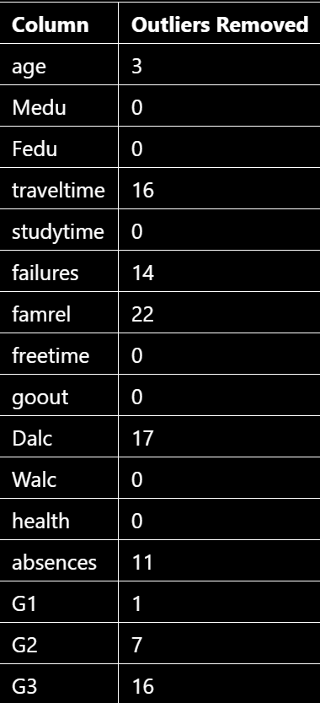
Removing the outliers
First problem we faced is the outlier rows that will affect the model

Slide 3
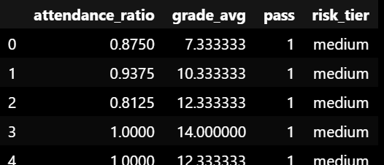
Feature Engineering
Adding more features that help us getting the model more accurate like:
Attendance ratio
Avg grades
Pass/fail
Risk tier(low, medium, high)

Slide 4
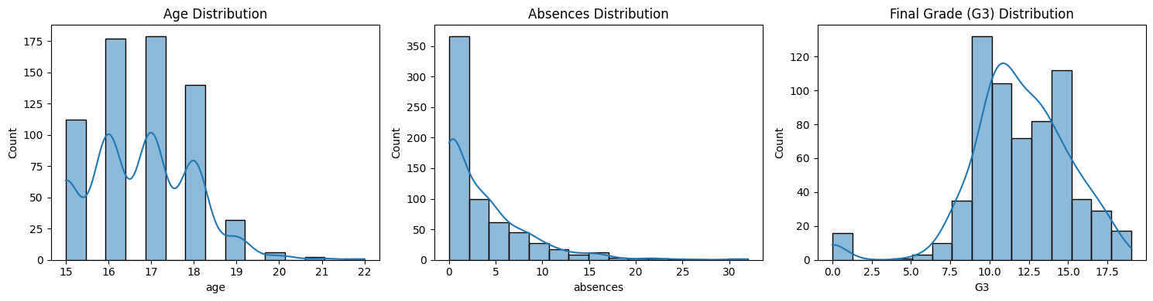
Visualization
Histogram for 3 numeric values
Age distribution
Number of absence and count for each one
Grades distribution for (G3) class

Slide 5
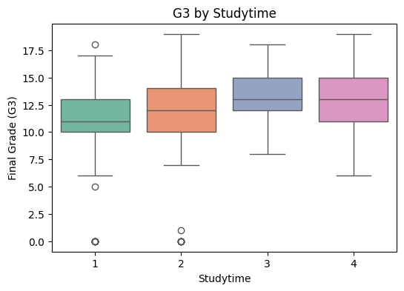
Boxplot for understanding the affection of study time over finals grades

Slide 6
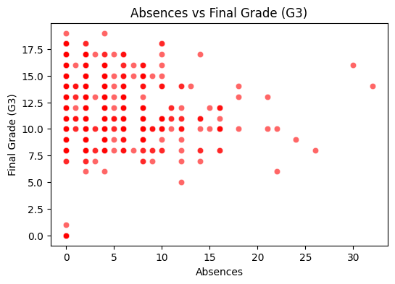
A scatter plot showing the relation between absence and exams final grades

Slide 7
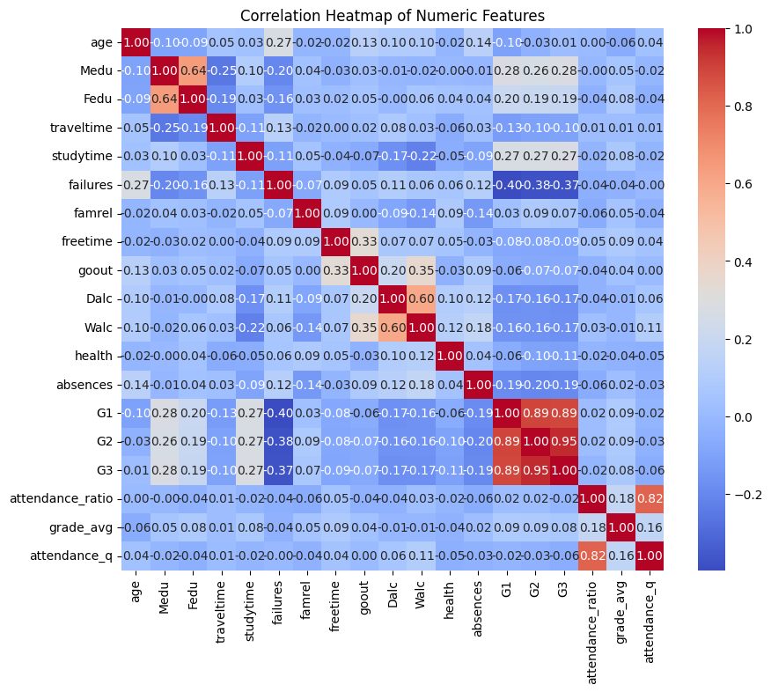
And finally Correlation heatmap shows the relation between numeric features

Slide 8
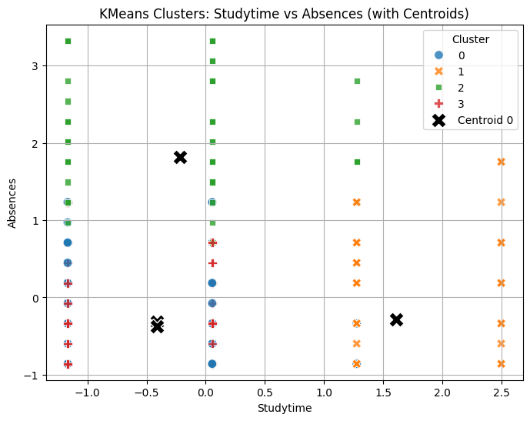
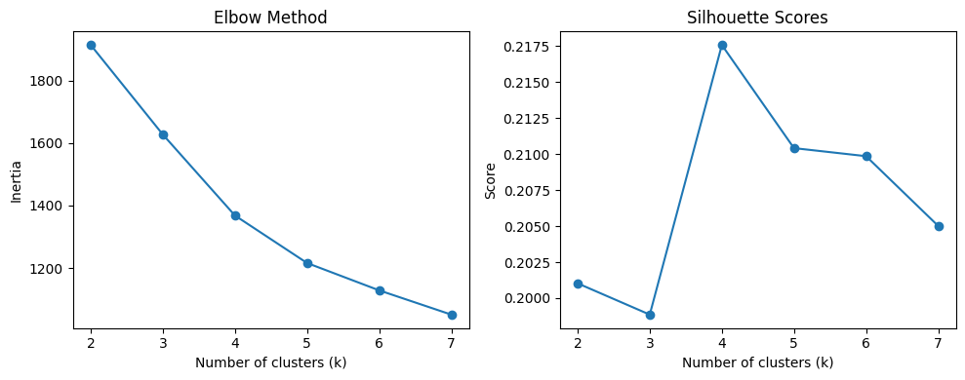
Building k-means clustering model
After processing and visualization, it’s time to build our models
First: k-mean model for clustering students based on their absence and study time
Using elbow method to select optimal number of cluster
Applying k-mean algorithm and visualize the result

Slide 9
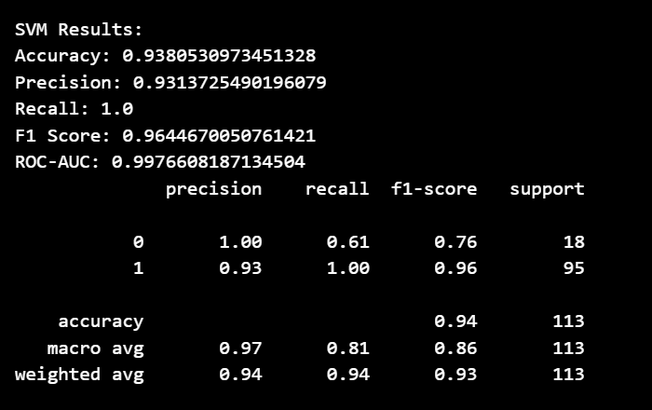
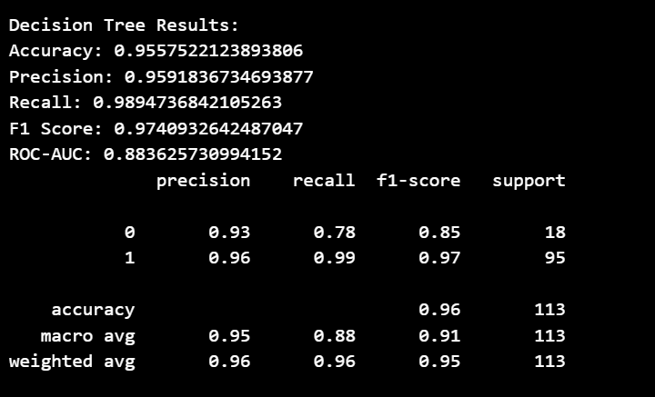
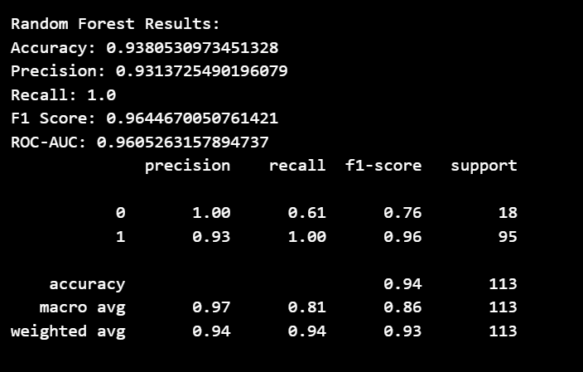
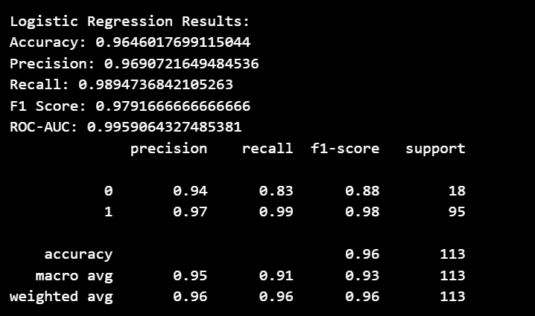
Supervised learning algorithm
Logistic Regression
Decision Tree
Random Forest
SVM
After training the model we have our models accuracy’s and models coefficients

Slide 10
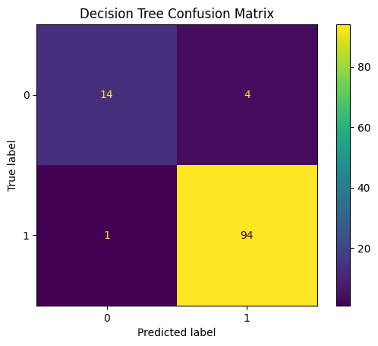
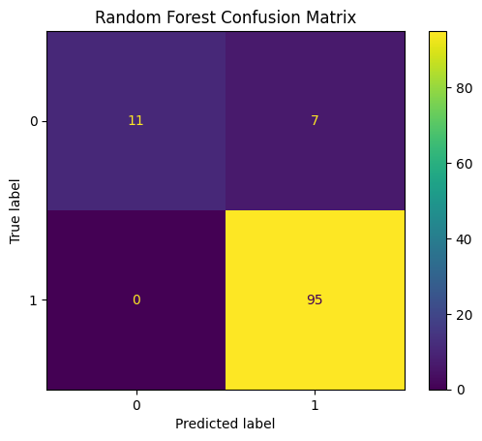
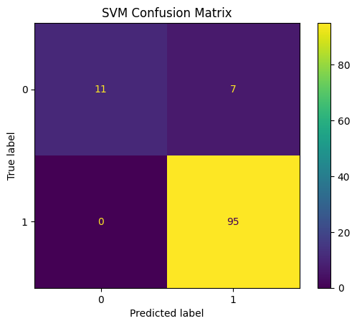
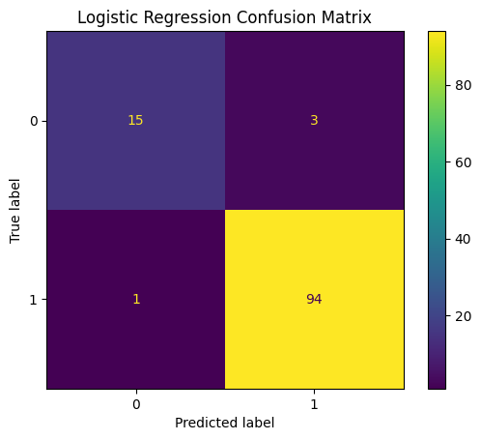
Confusion matrix for each algorithm
Logistic Regression
Decision Tree
Random Forest
SVM

Slide 11
Models insights
1. High Absences = Failure Strongly Increased Risk Students with high absences and two or more past failures have much higher odds of falling the final exam Action: Prioritize these students for attendance Interventions and early tutoring programs.
2. Low Study time = Lower Grades Students reporting low study time consistently score lower on G3. Action: Implement study skills workshops and encourage structured study schedules.
3. School Support (schools up) Improves Outcomes Students receiving school support show higher average grades. Action: Expand access to school support resources, especially for at-risk students.
4. Family Support (famsup)
Boosts Grade Average Family support is correlated with higher grade averages Action: Engage families through regular communication and offer family-based academic support sessions
5. Low Attendance Ratio = Lower Pass Rate Students in the lowest attendance quartile have the lowest pass rates. Action: Monitor attendance closely and Intervene early when patterns of absenteeism emerge.
6. Alcohol Consumption (Dalc/Walc) Linked to Lower Performance Higher daily/weeldy alcohol consumption is associated with lower grades. Action: Provide health education and counseling on substance use.
7. Social Activities (go out) Have Mixed Effects Moderate social activity is not harmful, but excessive going out correlates with lower grades.

Slide 12
Recommendations & decisions
• Use Random Forest for binary pass prediction.
• Exclude G1/G2 for early risk identification.
• Target interventions for students with high absences/failures.
• Expand school/family support programs.

